Slide 1





Project DKBank
Group 1 - Front End Developers
Mario Manitta
Zheming Zhang
Qiang Chen
Subin Noh

Slide 2
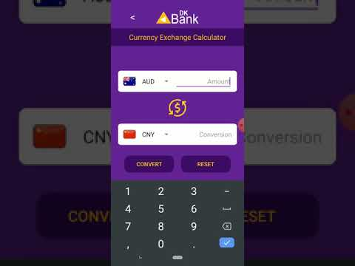




Slide 3

Mario
Team Leader

Slide 4
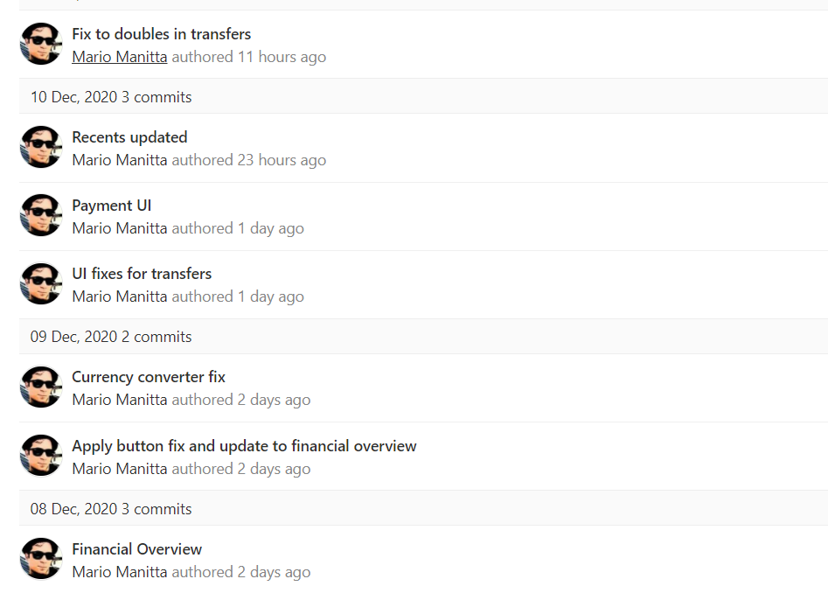
Mario - Team Leader
Tasks
Integrating work from other members
Design and Update UI
Fix and debug
Experiences
Challenging to integrate code with consistent format - it was not always just a process of merging code
Learnings
Automated testing with Katalon
Integrating cloud database (Firebase) into an app
Vietnamese culture

Slide 5
Qiang Chen
Developer

Slide 6
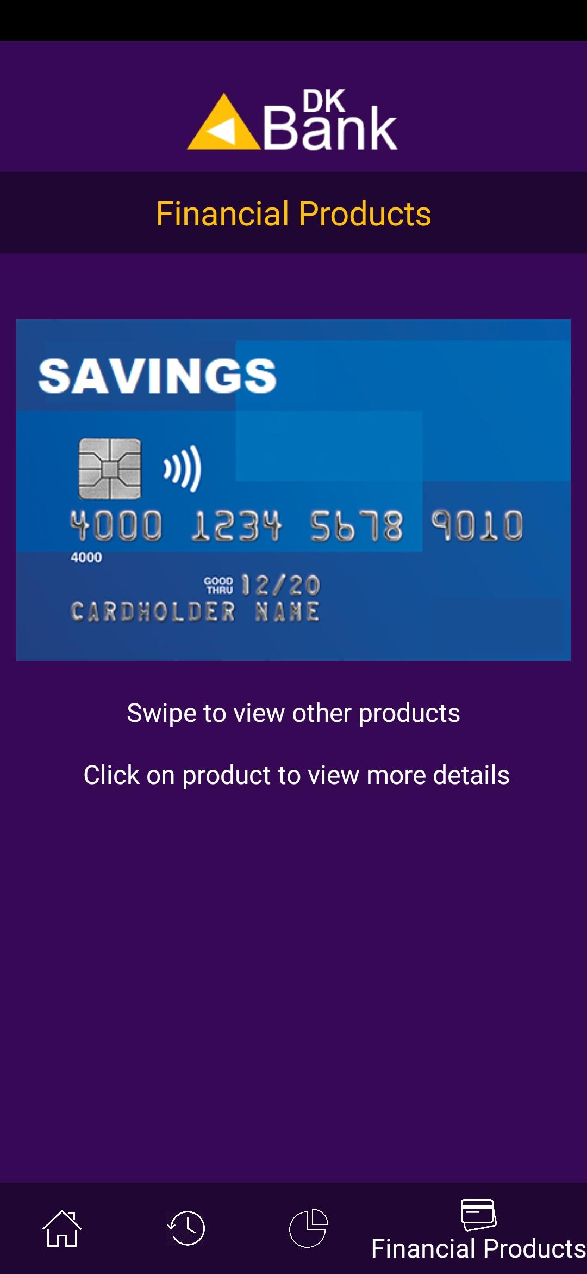
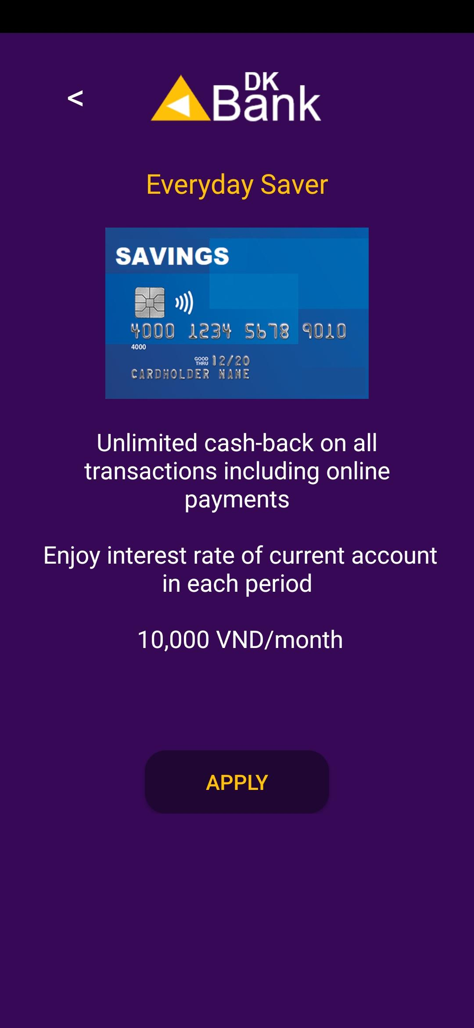
Application Features
Tasks
Design an advertisement function for financial products
Design UI for the advertisement

Slide 7
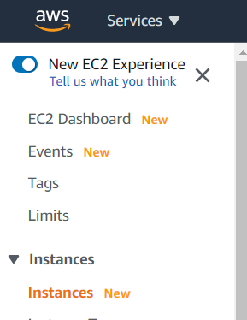
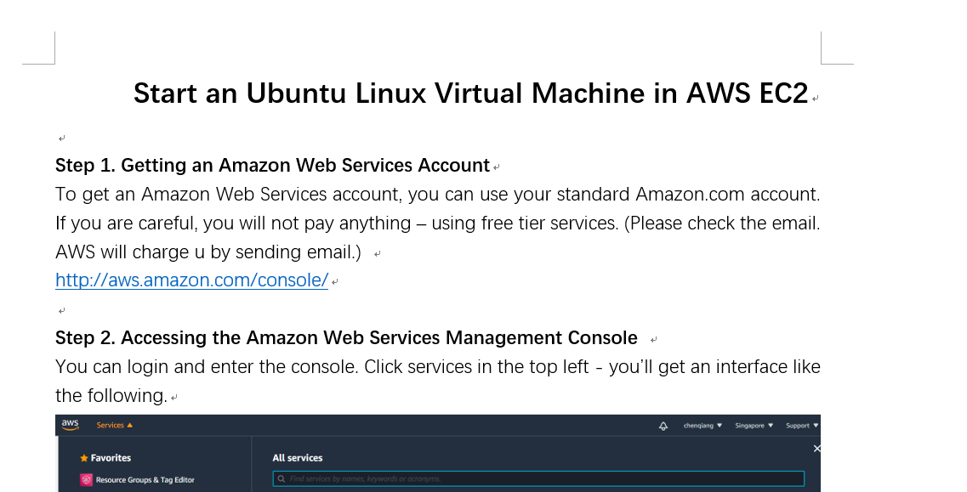
Research
AWS EC2

Slide 8
Qiang Chen - Team member
Tasks
Currency and Products function
Research (Database, AWS EC2)
Debugging and testing
Experiences
Android Studio programming and debug
Learnings
Programming skills and IT skills
Teamwork skills
Communication skills
Notes:
Mario

Slide 9
Zheming Zhang
Developer

Slide 10
Zheming Zhang - Team Member
Tasks
Currency calculator(Ebank app function)
Test Case/report writing
Research (banking app, common/highlighted features)
Experiences
Ebank project development
Daily schedule
Learnings
Compulsory IT skills
Soft skills/communication skills
Time arrangement
Suggestions

Slide 11
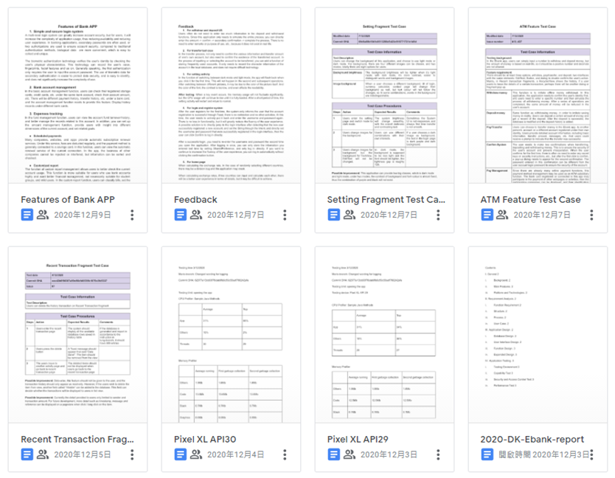
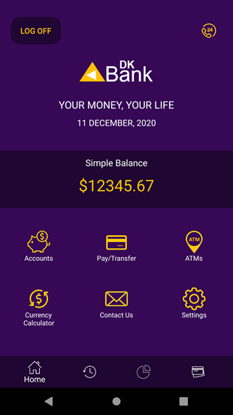
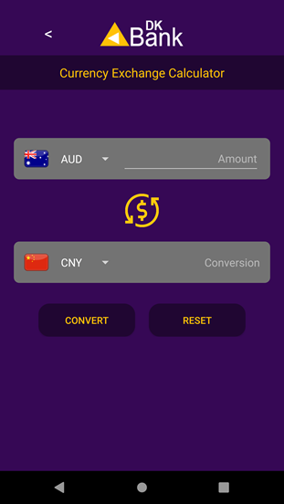
Application features/Tasks

Slide 12
Subin Noh
Developer

Slide 13
Subin Noh - Team member
Tasks
Research (MongoDB Database, Fingerprint, FaceID and QR detection)
Debugging and testing
Experiences
Challenging to create Face detection, Fingerprint and QR detection
Learnings
MongoDB database
FaceID, Fingerprint and QR detection
Vietnamese culture
Suggestions

Slide 14
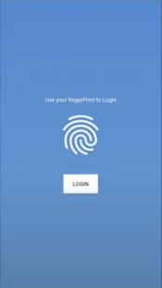
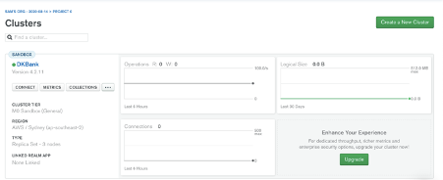
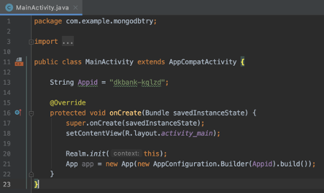
Application Features/Research

